Slide 1
Workplace Hazardous Materials Information System 2015
Geoffrey A. Clark, MSc., CIH, ROH
Sr. Occupational Hygienist
WorkSafeBC
Geoffrey.Clark@worksafebc.com
Colin.Murray@worksafebc.com
Dave.Garrett@worksafebc.com
Notes:
Welcome everyone.
Safety reminders – safety exits and meeting place etc.
Introductions – Name and SDL etc.

Slide 2
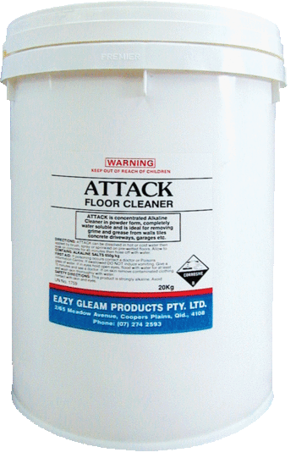
Purpose
To reduce the incidence of illness and injury by providing workers with information about hazardous materials used in the workplace.
Came into effect in July 2015.

Slide 3
WHMIS does not apply to everything
Explosives within the meaning of the Explosives Act
Cosmetics, food or drugs covered under the Food and Drugs Act
Pesticides within the meaning of the Pest Control Act
Prescribed substances covered under the Atomic Energy Control Act
Consumer products covered under the Consumer Product Safety Act
Others:
Wood and wood products
Tobacco and tobacco products
Manufactured products
Hazardous waste

Slide 4
Three key elements
Label – placed on containers to inform workers of the dangers of the products and basic safety procedures.
Safety Data Sheet (SDS) – bulletins that provide detailed hazard and precautionary information on the products.
Worker Education Program – provides instruction on hazards, how to work safely with the chemicals, spill cleanup and emergency procedures. Must be specific to the workplace.

Slide 5
What is GHS?
The Globally Harmonized System (GHS) is a worldwide system developed with the goal of standardizing the classification, labeling, and safety data sheet information for hazardous products.
Changes have been made to WHMIS to align with GHS, and this session is to inform you of what has changed, what remains the same, and the differences to GHS adopted in Canada for WHMIS 2015.
Notes:
WHMIS 2015 has been developed to align more closely with GHS and the US. Canada and the US have worked together to align their requirements to GHS.
For various reasons there are a few differences between Canada and the US (the legislative frameworks are slightly different and any changes adopted need to work with the legislation) – for example, Canada has the dual language requirements (English and French) for all supplier labels and safety data sheets. Whereas the US only requires the labels to be in English.
The two major elements of GHS are:
1. Classification of the hazards of chemicals according to the GHS rules:
GHS provides guidance on classifying pure chemicals and mixtures according to its criteria or rules.
2. Communication of the hazards and precautionary information using Safety Data Sheets and labels:
Labels - With the GHS system, certain information will appear on the label. For example, the chemical identity may be required. Standardized hazard statements, signal words and symbols will appear on the label according to the classification of that chemical or mixture. Precautionary statements may also be required, if adopted by your regulatory authority.
Safety Data Sheets (SDS) - The GHS SDS has 16 sections in a set order, and minimum information is prescribed.
What are some key terms in the GHS Vocabulary?
SDS - Safety Data Sheet. SDS is the term used by GHS for Material Safety Data Sheet (MSDS).
Hazard group - While not given a formal definition, GHS divides hazards into three major groups - health, physical and environmental.
Class - Class is the term used to describe the different types of hazards. For example, Gases under Pressure is an example of a class in the physical hazards group.
Category - Category is the name used to describe the sub-sections of classes. For example, Self-Reactive Chemicals have 7 categories. Each category has rules or criteria to determine what chemicals are assigned to that category. Categories are assigned numbers (or letters) with category 1 (or A) being the most hazardous.
Hazard Statement - For each category of a class, a standardized statement is used to describe the hazard. For example, the hazard statement for chemicals which meet the criteria for the class Self-heating substances and mixtures, Category 1 is Self-heating; may catch fire. This hazard statement would appear both on the label and on the SDS.
Precautionary Statement - These statements are standardized phrases that describe the recommended steps to be taken to minimize or prevent adverse effects from exposure to or resulting from improper handling or storage of a hazardous product.
Signal word - There are two signal words in the GHS system - Danger and Warning. These signal words are used to communicate the level of hazard on both the label and the SDS. The appropriate signal word to use is set out by the classification system. For example, the signal word for Self-heating substances and mixtures, Category 1 is Danger while Warning is used for the less serious Category 2. There are categories where no signal word is used.
Pictogram - Pictogram refers to the GHS symbol on the label and SDS. Not all categories have a symbol associated with them.

Slide 6
Hazard groups
WHMIS 2015 applies to two major groups of hazards from the three identified in GHS: physical, and health. WHMIS 2015 has not adopted the environmental hazard group.
Each group includes hazard classes that have specific hazardous properties.
Physical hazards
Based on the physical or chemical properties of the product - such as flammability, reactivity, or corrosivity to metals.
Health hazards
Based on the ability of the product to cause a health effect - such as eye irritation, respiratory sensitization (may cause allergy or asthma symptoms or breathing difficulties if inhaled), or carcinogenicity (may cause cancer).
Notes:
GHS defines a third group, Environmental hazards. This group (and its classes) was not adopted in WHMIS 2015. However, you may see the environmental classes listed on labels and Safety Data Sheets (SDSs).
WHMIS 2015 allows inclusion of environmental hazard information.
Which products are not covered by WHMIS?
The exclusions under WHMIS 2015 are:
Explosives as defined in the Explosives Act.
Cosmetic, device, drug or food as defined in the Food and Drugs Act.
Pest control products as defined in the Pest Control Products Act.
Consumer products as defined in the Canada Consumer Product Safety Act.
Wood or products made of wood.
Nuclear substances within the meaning of the Nuclear Safety and Control Act, that are radioactive.
Hazardous waste being a hazardous product that is sold for recycling or recovery and is intended for disposal.
Tobacco and tobacco products as defined in the Tobacco Act.
Manufactured articles.
Many of these products are covered under other legislation. Note that while a product may be exempt from the requirement to have a WHMIS label and SDS, employers must still provide education and training on health effects, safe use, and storage.

Slide 7
Hazard classes
Hazard classes group together products that have similar properties.
For example:
Hazard Class | General Description
Flammable gases Flammable aerosols Flammable liquids Flammable solids | These four classes cover products that have the ability to ignite (catch fire) easily and the main hazards are fire or explosion.
Oxidizing gases Oxidizing liquids Oxidizing solids | These three classes cover oxidizers, which may cause or intensify a fire or cause a fire or explosion.
Gases under pressure | This class includes compressed gases, liquefied gases, dissolved gases and refrigerated liquefied gases. Compressed gases, liquefied gases and dissolved gases are hazardous because of the high pressure inside the cylinder or container. The cylinder or container may explode if heated. Refrigerated liquefied gases are very cold and can cause severe cold (cryogenic) burns or injury.
Notes:
Most hazard classes are common to GHS, and will be used worldwide by all countries that have adopted GHS. Some hazard classes are specific to WHMIS 2015.
Note: GHS also defines an Explosive class and the Environmental Hazards group (not mandatory).
The WHMIS regulations do not currently include the Explosives hazard class. Explosives are covered by other legislation in Canada.
Physical Hazards
Flammable gases
Flammable aerosols
Oxidizing gases
Gases under pressure
Flammable liquids
Flammable solids
Self-reactive substances and mixtures
Pyrophoric liquids
Pyrophoric solids
Self-heating substances and mixtures
Substances and mixtures which, in contact with water, emit flammable gases
Oxidizing liquids
Oxidizing solids
Organic peroxides
Corrosive to metals
Combustible dusts
Simple asphyxiants
Pyrophoric gases
Physical hazards not otherwise classified
Health Hazards
Acute toxicity
Skin corrosion/irritation
Serious eye damage/eye irritation
Respiratory or skin sensitization
Germ cell mutagenicity
Carcinogenicity
Reproductive toxicity
Specific target organ toxicity – single exposure
Specific target organ toxicity – repeated exposure
Aspiration hazard
Biohazardous infectious materials
Health hazards not otherwise classified

Slide 8
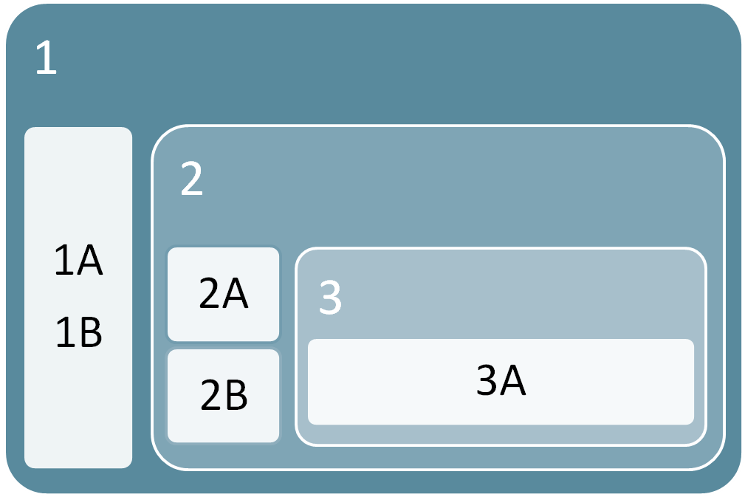
Hazard categories and rule
Each hazard class contains at least one category.
The hazard categories are assigned a number (e.g., 1, 2, etc.)
Categories may also be called "types". Types are assigned an alphabetical letter (e.g., A, B, etc.).
Subcategories are identified with a number and a letter (e.g., 1A and 1B).
1
1A
1B
2
2A
3
3A
2B
High Hazard
Low Hazard
Notes:
Each hazard class contains at least one category. The hazard categories are assigned a number (e.g., 1, 2, etc.) Categories may also be called "types". Types are assigned an alphabetical letter (e.g., A, B, etc.). In a few cases, sub-categories are also specified. Subcategories are identified with a number and a letter (e.g., 1A and 1B).
Some hazard classes have only one category (e.g., corrosive to metals), others may have two categories (e.g., carcinogenicity (cancer)) or three categories (e.g., oxidizing liquids). There are a few hazard classes with five or more categories (e.g., organic peroxides).
The category tells you about how hazardous the product is (that is, the severity of hazard).
Category 1 is always the greatest level of hazard (that is, it is the most hazardous within that class). If Category 1 is further divided, Category 1A within the same hazard class is a greater hazard than category 1B.
Category 2 within the same hazard class is more hazardous than category 3, and so on.
There are a few exceptions to this rule. For example, for the Gases under pressure hazard class, the hazard categories are "Compressed gas", "Liquefied gas", "Refrigerated liquefied gas" and "Dissolved gas". These classes relate to the physical state of the gas when packaged and do not describe the degree of hazard.
In addition, the Reproductive Toxicity hazard class has a separate category called "Effects on or via lactation". "Effects on or via lactation" was not assigned a specific numbered category. Reproductive toxicity also has Categories 1 and 2 which relate to effects on fertility and/or the unborn child. Effects on or via lactation is considered a different, but related hazard within the Reproductive toxicity class.
Where a ‘Type’ definition is used instead of a category number, ‘A’ poses the highest level of hazard.

Slide 9
Hazard identification – flammable liquids
Hazard Groups:
Physical Hazards
Flammable/combustible
Health Hazards
(Environmental Hazards)
Hazard Classes:
Flammable gases
Flammable aerosols
Flammable liquids
Flammable solids
Hazard Categories:
Flammable liquids – Category 1
(flash point < 23°C; boiling point <= 35°C)
Flammable liquids – Category 2
(fp < 23°C; bp > 35°C)
Flammable liquids – Category 3
(fp > 23°C and <= 60°C)
Flammable liquids – Category 4
(fp > 60°C and <= 93°C)
Notes:
Most hazard classes are common to GHS, and will be used worldwide by all countries that have adopted GHS. Some hazard classes are specific to WHMIS 2015.
Note: GHS also defines an Explosive class and the Environmental Hazards group (not mandatory).
The WHMIS regulations do not currently include the Explosives hazard class. Explosives are covered by other legislation in Canada.
Physical Hazards
Flammable gases
Flammable aerosols
Oxidizing gases
Gases under pressure
Flammable liquids
Flammable solids
Self-reactive substances and mixtures
Pyrophoric liquids
Pyrophoric solids
Self-heating substances and mixtures
Substances and mixtures which, in contact with water, emit flammable gases
Oxidizing liquids
Oxidizing solids
Organic peroxides
Corrosive to metals
Combustible dusts
Simple asphyxiants
Pyrophoric gases
Physical hazards not otherwise classified
Health Hazards
Acute toxicity
Skin corrosion/irritation
Serious eye damage/eye irritation
Respiratory or skin sensitization
Germ cell mutagenicity
Carcinogenicity
Reproductive toxicity
Specific target organ toxicity – single exposure
Specific target organ toxicity – repeated exposure
Aspiration hazard
Biohazardous infectious materials
Health hazards not otherwise classified

Slide 10
Hazard category exceptions
There are a few exceptions to this rule.
Gases under pressure hazard class, the hazard categories are:
Compressed gas
Liquefied gas
Refrigerated liquefied gas
Dissolved gas
These classes relate to the physical state of the gas when packaged and do not describe the degree of hazard.
Reproductive Toxicity hazard class has a separate category called “Effects on or via lactation”.
Notes:
There are a few exceptions to this rule. For example, for the Gases under pressure hazard class, the hazard categories are "Compressed gas", "Liquefied gas", "Refrigerated liquefied gas" and "Dissolved gas". These classes relate to the physical state of the gas when packaged and do not describe the degree of hazard.
In addition, the Reproductive Toxicity hazard class has a separate category called "Effects on or via lactation". "Effects on or via lactation" was not assigned a specific numbered category. Reproductive toxicity also has Categories 1 and 2 which relate to effects on fertility and/or the unborn child. Effects on or via lactation is considered a different, but related hazard within the Reproductive toxicity class.

Slide 11
Compressed gases
WHMIS 1988
Class A – Compressed gases
WHMIS 2015
Gases under pressure.
The gas cylinder pictogram is used for Gases under pressure
Compressed gas
Liquefied gas
Refrigerated liquefied gas
Dissolved gas
Notes:
Note the new pictogram – the central image has not changed much, however the border is now a red diamond instead of the black circle.
Gases under pressure. This class includes compressed gases, liquefied gases, dissolved gases and refrigerated liquefied gases. Compressed gases, liquefied gases and dissolved gases are hazardous because of the high pressure inside the cylinder or container. The cylinder or container may explode if heated. Refrigerated liquefied gases are very cold and can cause severe cold (cryogenic) burns or injury.

Slide 12
Fire hazards
WHMIS 1988
Class B – Flammable/Combustible Materials
Substances capable of catching fire or exploding.
WHMIS 2015
The flame pictogram is used for the following classes and categories:
Flammable gases (Category 1)
Flammable aerosols (Category 1 and 2)
Flammable liquids (Category 1, 2 and 3)
Flammable solids (Category 1 and 2)
Notes:
Flammable gases (Category 1)
Flammable aerosols (Category 1 and 2)
Flammable liquids (Category 1, 2 and 3)
Flammable solids (Category 1 and 2)
Pyrophoric liquids (Category 1)
Pyrophoric solids (Category 1)
Pyrophoric gases (Category 1)
Self-heating substances and mixtures (Category 1 and 2)
Substances and mixtures which, in contact with water, emit flammable gases (Category 1, 2 and 3)
Self-reactive substances and mixtures (Types B*, C, D, E and F)
Organic peroxides (Types B*, C, D, E and F)

Slide 13
Oxidizing hazards
WHMIS 1988
Class C – Oxidizer
Products causing/ contributing to the combustion of other materials.
WHMIS 2015
The flame over circle pictogram is used for the following classes and categories:
Oxidizing gases (Category 1)
Oxidizing liquids (Category 1, 2 and 3)
Oxidizing solids (Category 1, 2 and 3)

Slide 14
Explosive or extremely reactive
WHMIS 1988
Class F – Dangerously Reactive Materials
Products which can undergo dangerous reaction if subject to heat, light, pressure, shock, water, air.
WHMIS 2015
Reactivity hazards.
The exploding bomb pictogram is used for the following classes and categories:
Self-reactive substances and mixtures (Types A and B)
Organic peroxides (Types A and B)
Note: Under GHS this pictogram also represents explosives, which has not been adopted in the HPR.

Slide 15
Corrosion
WHMIS 1988
Class E – Corrosive materials
Materials such as caustics or acids causing burns to skin
or eyes.
WHMIS 2015
For corrosive damage to metals, as well as skin, eyes.
The corrosion pictogram is used for the following classes and categories:
Corrosive to metals (Category 1)
Skin corrosion/irritation - Skin corrosion (Category 1, 1A, 1B and 1C)
Serious eye damage/eye irritation - Serious eye damage (Category 1)

Slide 16
Acute toxicity (skull and crossbones)
WHMIS 1988
Class D – Poisonous and Infectious (D1)
Materials causing immediate and serious toxic effects.
WHMIS 2015
Can cause death or toxicity with short exposure to small amounts.
The skull and crossbones pictogram is used for the following classes and categories:
Acute toxicity -
Oral (Category 1, 2 and 3)
Dermal (Category 1, 2 and 3)
Inhalation (Category 1, 2 and 3)

Slide 17
Acute toxicity (exclamation mark)
WHMIS 1988
X
Class D – Poisonous and Infectious (D2)
Materials causing other toxic effect - immediate skin or eye irritation - chronic health effects on body organs, cardiovascular or nervous system.
WHMIS 2015
May cause less serious health effects.
Acute toxicity – oral, dermal, inhalation (Category 4),
Skin corrosion/irritation – skin irritation (Category 2)
Serious eye damage/eye irritation - eye irritation (Category 2 and 2A)
Respiratory or skin sensitization - skin sensitizer (Category 1, 1A and 1B)
Specific target organ toxicity - single exposure (Category 3)

Slide 18
Health hazard
May cause, or is suspected of causing serious health effects.
The health hazard pictogram is used for the following classes and categories:
Respiratory or skin sensitization - Respiratory sensitizer (Category 1, 1A and 1B)
Germ cell mutagenicity (Category 1, 1A, 1B and 2)
Carcinogenicity (Category 1, 1A, 1B, and 2)
Reproductive toxicity (Category 1, 1A, 1B and 2)
Specific Target Organ Toxicity - Single exposure (Category 1 and 2)
Specific Target Organ Toxicity - Repeated exposure (Category 1 and 2)
Aspiration hazard (Category 1)

Slide 19
Biohazard
Retained – used for organisms and toxins that can cause diseases in people or animals.
WHMIS 1988
Class D – Poisonous and Infectious (D3)
WHMIS 2015
The biohazardous and infectious materials pictogram is used for Biohazardous Infectious Materials (Category 1).
Notes:
This has been retained from WHMIS 1988.

Slide 20
Environment
GHS defines an Environmental hazards group which has not been adopted for WHMIS 2015.
However, you may see the labels and information from this group as it has not been specifically excluded for WHMIS and will be used in other jurisdictions such as the USA.
Notes:
We need to explain this for information only.

Slide 21
Do all hazard classes and categories require a pictogram?
No. There are hazardous products that meet the criteria for a hazard class or category, but these classes and categories do not require a pictogram.
The product label and Section 2 (Hazards Identification) of the SDS still require the signal word, hazard statement(s), and other required label elements.

Slide 22
No pictogram required
The following WHMIS 2015 classes and categories that do not require a pictogram:
Flammable gases - Category 2
Flammable liquids - Category 4
Self-reactive substances and mixtures - Type G
Organic peroxides - Type G
Combustible dusts - Category 1
Simple Asphyxiants - Category 1
Serious eye damage/eye irritation - Eye Irritation - Category 2B
Reproductive toxicity - Effects on or via lactation

Slide 23
There are lots of pictograms out there …
WHMIS 1988
WHMIS 2015
Consumer Products

Slide 24
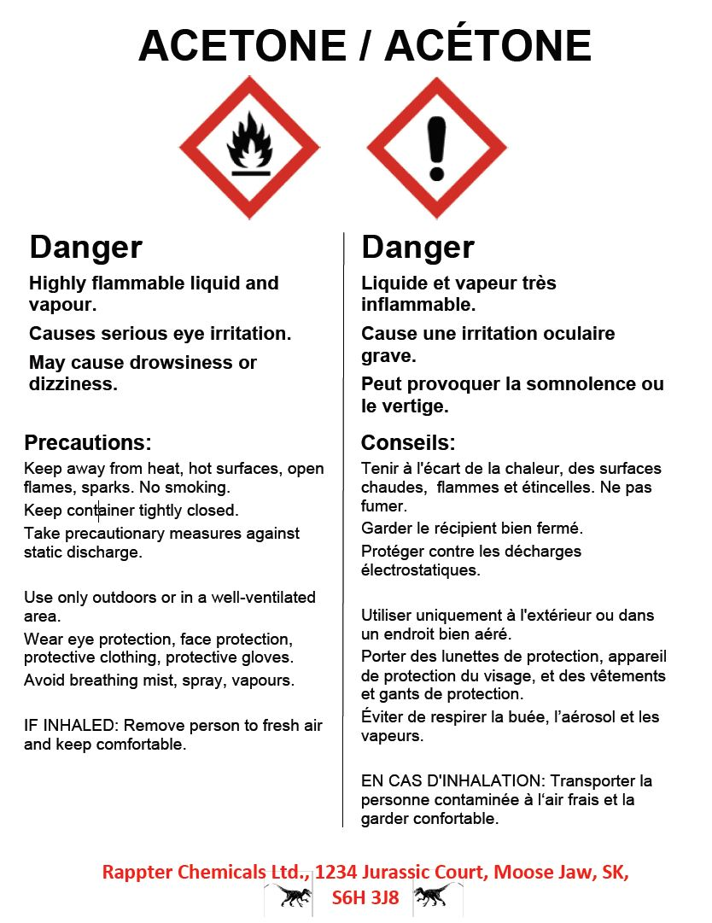
Supplier labels
WHMIS 1988
WHMIS 2015
Notes:
Hazardous Ingredients
Although disclosure of hazardous ingredients on a label is not required, the supplier may choose to include them. However, there are requirements for disclosing hazardous substances and ingredients on the SDS.

Slide 25
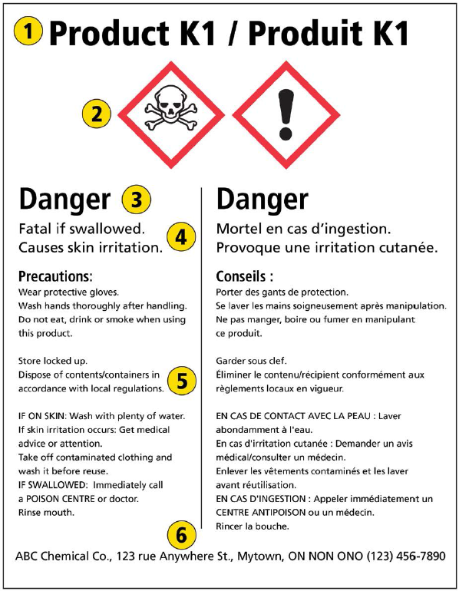
WHMIS 2015 supplier labels
Supplier labels must be bilingual (English/French), easy to read and durable.
The pictogram(s), signal word and hazard statement(s) must be grouped together on a supplier label.
The label must contain the following information:
Product identifier
Hazard pictograms
Signal word
Hazard statements
Precautionary statements
Supplier identifier
Note: The information on the supplier label should match the information listed in section 2 of the SDS.
Notes:
If the label is lost, damaged, or no longer readable, the product must be relabeled with a new supplier label or a workplace label.
Hazardous Ingredients
Although disclosure of hazardous ingredients on a label is not required, the supplier may choose to include them. However, there are requirements for disclosing hazardous substances and ingredients on the SDS.
For WHMIS 2015 the hatched border is no longer required.

Slide 26
Workplace labels
WHMIS 1988
WHMIS 2015
Applied to:
Secondary containers
Containers of products received in bulk
Employer-produced products
Containers with lost or defaced supplier labels
Contains the following:
Product name
Safe handling procedures
Reference to the MSDS/SDS
Notes:
Note: WHMIS 2015 – the warning/danger signal word is not required under BC OHS, however, employers may decide to include it as good practice.
The safe handling procedures are more prominent.

Slide 27
Alternate modes of identification
If a hazardous product is contained or transferred in:
A pipe, or piping systems including valves.
A process or reaction vessel.
A tank car, tank truck, ore care, conveyor belt or similar conveyance.
Labels, placards, or colour codings are acceptable identification as long as workers are trained in the safe use, storage, and handling.

Slide 28
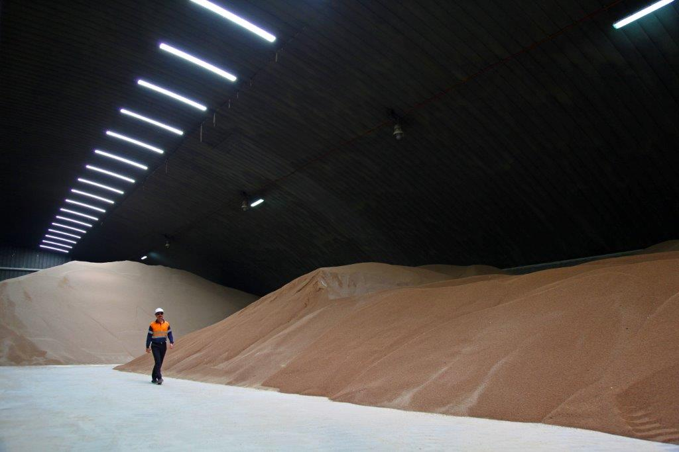
Bulk storage
If an unpackaged hazardous product or a hazardous product transported as a bulk shipment is received and is exempt under HPR from having a supplier label, a label containing the information needed on a supplier label is required when that product is stored at the workplace.
Notes:
This is a change from WHMIS 1988, where a workplace label would be an acceptable form of signage.

Slide 29
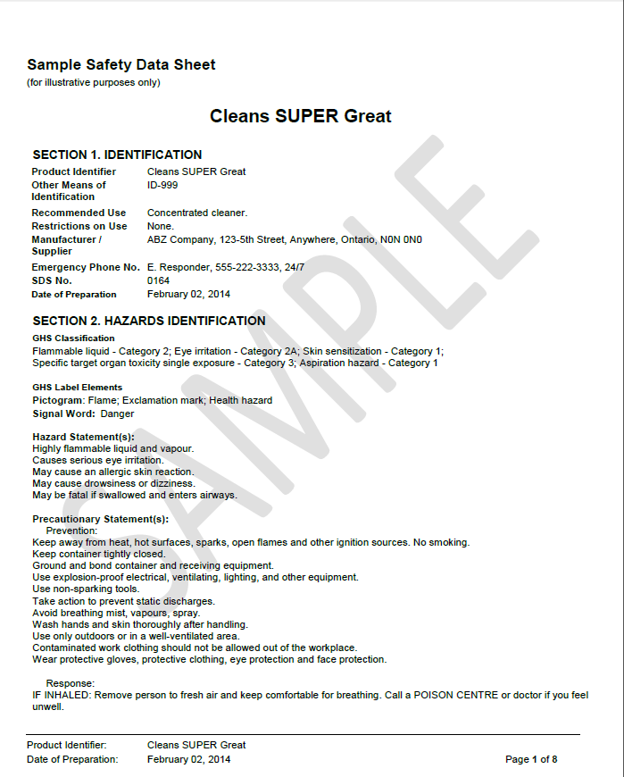
Safety Data Sheet (SDS)
16 Heading sections:
Identification
Hazard identification (e.g., label elements)
Composition/Information on ingredients
First-aid measures
Fire-fighting measures
Accidental release measures
Handling and storage
Exposure controls/Personal protection
Physical and chemical properties
Stability and reactivity
Toxicological information
Ecological information (Optional in Canada)
Disposal considerations (Optional in Canada)
Transport information (Optional in Canada)
Regulatory information (Optional in Canada)
Other information
If information for any section is either not available or not applicable, the words must be typed in full. N/A is not acceptable because it could mean either of these phrases.
Notes:
MSDS becomes SDS
Sections 12, 13, 14, and 15 are optional in Canada, however the headings must be present in Canada and the information is required for the U.S. and other countries.
Section 2 contains the information which should be on the supplier label.
For anyone wondering about the exemptions under WHMIS 2015, they have not changed. Exemptions remain the same as they are currently.
If information for any section is either not available or not applicable, the words must be typed in full. N/A is not acceptable because it could mean either of these phrases.

Slide 30
Confidential business information
Chemical (%) Example | WHMIS 1988 | WHMIS 2015 | US GHS
Toluene (17%) No CBI | Toluene (17%) [Toluene 10-30%] | Toluene (17%) | Toluene (17%)
Acetone (32-41%) No CBI | Acetone (30-60%) | Acetone (32-41%) | Acetone (32-41%)
Toluene (17%) With CBI | Toluene (trade secret) registry number range (optional) | Toluene (trade secret) Registry number range (optional) | Toluene (trade secret) range (optional)
Acetone (32-41%) With CBI | Acetone (trade secret) registry number | Acetone (trade secret) registry number | Acetone (32-41%) CBI not allowed True “range” must be disclosed

Slide 31
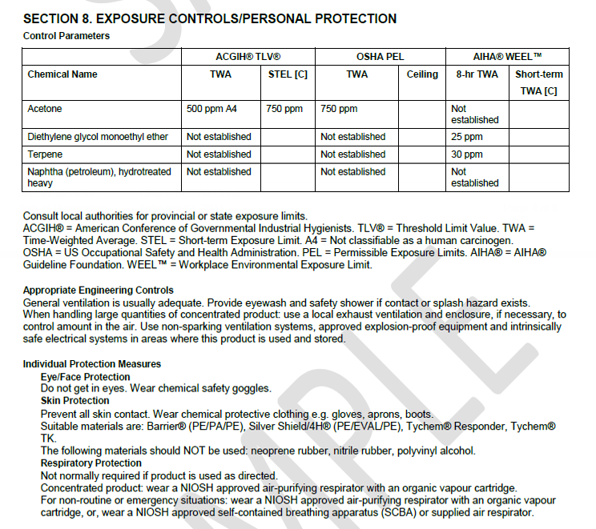

Slide 32
Section 12: Ecological information
The Ecological Information section would include:
Ecotoxicity
Persistence and degradability
Bioaccumulative potential
Mobility in soil
Other adverse effects
This heading must be present, but under Canadian regulations, the supplier has the option to not provide information in this section.

Slide 33
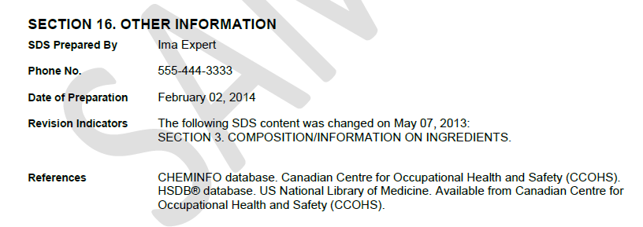
Section 16: Other information
This section must include the date of the latest revision of the SDS.

Slide 34
Timeframe
The Controlled Products Regulation (CPR) has been replaced with the Hazardous Products Regulation (HPR).
Implementation of the changes takes place over a 3 year period between now and November 30th 2018.
After December 1st 2018, manufacturers, distributors and employers must all comply with the HPR.

Slide 35
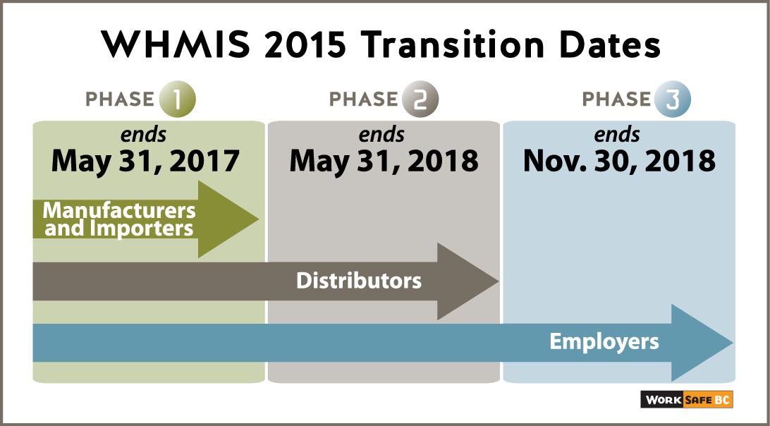
WHMIS 1988 – WHMIS 2015 transition
Notes:
How long will WHMIS transition last?
Health Canada has developed the approach for transition to WHMIS 2015 based on consultation with stakeholders and WHMIS partners. WHMIS transition will occur in three phases, starting with the coming-into-force of the amended HPA and HPR and concluding in December 2018.
During the first phase, which started with the coming-into-force of WHMIS 2015 on February 11, 2015, suppliers are able to comply with either the old HPA and CPR (WHMIS 1988) or the new requirements of the HPA and HPR (WHMIS 2015). The first phase of transition will end on May 31, 2017, at which point the transition for manufacturers and importers of hazardous products would be completed (i.e. manufacturers and importers would be required to only sell or import hazardous products with labels and SDSs that are compliant with WHMIS 2015).
During the second phase, which starts on June 1, 2017 and ends on May 31, 2018, suppliers importing for their own use and distributors would be able to continue to sell and/or import hazardous products with labels and (M)SDSs based on either WHMIS 1988 or WHMIS 2015 requirements.
During the third phase (June 1, 2018 to November 30, 2018), manufacturers, importers, distributors and suppliers importing for their own use are required to sell or import only those hazardous products that are compliant with WHMIS 2015. At this point, transition to WHMIS 2015 is complete for all suppliers.
By December 1, 2018, all suppliers and employers will be required to be in compliance with the new HPA and HPR.

Slide 36
Regulation and Enforcement - Federal
HPA/CPR to HPA/HPR (“controlled” has been changed to “hazardous”)
MSDS to SDS with more required sections
More details in information required by importers/manufacturers/suppliers on SDSs
New pictograms
New method of classification, especially for old “Class D – Poisonous and Infectious Materials”
Codified risk and precaution phrases
Supplier labels have fewer sections

Slide 37
Regulation and Enforcement - Provincial
Provincial WHMIS requirements have been adapted to align with new federal requirements.
While some provinces have chosen to drop the 3 year (M)SDS time limit, BC will keep this requirement .
Other sections of the OHS Reg and guidelines that have reference to WHMIS 1988 have been revised to reflect WHMIS 2015.
Some examples are:
Toxic Process Gases
High Risk Violations Guidelines
Emergency Washing Facilities – Risk Assessment

Slide 38
Who Enforces What?
Hazardous Products
Importation & Sale
Use, Storage & Handling
Federal
HPA, HPR, & HMIRA
Provincial
OH&S Regulation
Classification
Safety
Data Sheets
Supplier Labels
Education and Training
Workplace Labels
Manufacturer/Supplier
Workplace/Employer

Slide 39
Education requirements
Labelling/M(SDS) On Site
WHMIS 1988 only | Educate and train on 1988 system
WHMIS 2015 only | Educate and train on 2015 system
WHMIS 1988 and 2015 | Educate and train on both systems
Notes:
WHMIS is more than being able to understand the content of a label and (M)SDS
Employer must train and provide instruction specific to the workplace on:
(a) procedures for the safe use, storage, handling and disposal of the hazardous product,
(b) procedures to be followed if the hazardous product escapes/spills
(c) procedures to be followed in case of an emergency involving a hazardous product.

Slide 40
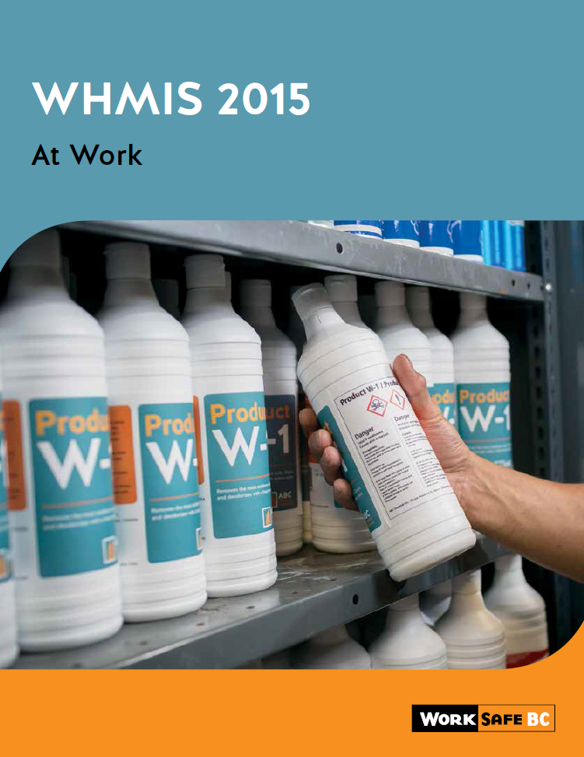
WorkSafeBC - WHMIS
Three publications will be modified to correspond to WHMIS 2015, which could include information from CCOHS :
WHMIS at Work
WHMIS the Basics
WHMIS Instructor’s Manual
WHMIS Participant Workbook
We will not be revising (or reprinting):
WHMIS Core Manual
WHMIS Supplier’s Guide
Two old WHMIS videos
We will be creating two new videos for WHMIS 2015:
A WHMIS “coming soon trailer”
A WHMIS training-style video (not likely to be ready until the fall)
New WorkSafeBC page layout.
Notes:
Note the new page has the WHMIS 2015 information in a separate column from the WHMIS 1988 information.

Slide 41
The system is working when …
Workers can answer the following questions when using hazardous products:
What are the hazards associated with the product?
How do I protect myself from these hazards?
What do I do in case of an emergency?
Where can I obtain more information?

Slide 42
Questions?
Notes:
42
Conclusion

