Slide 1
Blood Borne Pathogens Exposure Control
Organizational Safety - Revised November 2018
Notes:
COV’s commitment to eliminate/minimize risk of infection potentially faced by employees. Applies to most City operations, but does not cover all instances – so some workgroups may have their own specific work procedures.

Slide 2
Objectives
Learn about the City’s Blood Borne Pathogen (BBP) Exposure Control Plan
Understand the risks of BBPs
Know how to protect yourself
Know what to do if the event of exposure to blood and bodily fluids
Notes:
Roles and Responsibilities
Safety – update & improve the BBPECP, provide education, review SWPs
Managers – ensure workers receive education & training
Supervisors – ensure exposed workers report to St.Paul’s immediately, make containers and instruments available
Workers – report incidents, follow SWP, receive vaccinations (voluntary), participate in education

Slide 3
BBP Exposure Control Plan
What is a BBP?
BBP controls risk of exposure to:
Hepatitis B
Hepatitis C
HIV
Notes:
A micro-organism that is transmitted thru the exchange of blood or body fluids and have the ability to cause disease in humans.
Blood and some bodily fluids are capable of carrying pathogens, but the most common BBPs are Hep B, Hep C and HIV.
Note: Hep A virus not BBP bc the virus is usually spread through the fecal-oral route; transmitted person-to-person by ingestion of contaminated food or water or through direct contact with an infectious person.

Slide 4
BBP ECP Access
Available from your supervisor from the Organizational Safety page:

Slide 5
Jobs Identified as at risk for exposure
First Aid Attendants
Operations Workers
Equipment Operators
Mechanics
Tire Workers
Gardeners
Plumbers
Building Service Workers
Parking Meter Mechanics and Enforcement Officers
Notes:
The Exposure Control Plan (ECP) identifies jobs that are potentially at-risk of contacting blood and body fluid (Section 3.3 of the ECP).
Tasks that create risk:
First aid
High risk environment – e.g. needles and blood spills are more common in some locations
Needle Pickup
Site inspections – e.g. finding discarded needles at construction sites/in parking meters
Outdoor maintenance – e.g. finding needles in bushes, lawn, valve/meter boxes, cb’s, manholes, etc.

Slide 6
BBPs – How are they transmitted?
Blood and sexual fluids have a high risk of infectious potential
Feces, snot, phlegm, tears, urine, vomit have minimal risk or infectious potential unless blood is present in these fluids
Notes:
Dependent on the concentration of viruses contained in the fluid.
Blood is the most concentrated fluid with blood borne viruses. It could be as high as a million viruses in a single drop of blood.
Sexual fluids are not as concentrated - contact with condoms is an example of being exposed.
The other fluids are either free of viruses or may have just a few viruses in them. The greatest concern is if blood is mixed with these fluids.
It is important to remember one virus entering you will not infect you, a significant number have to get into you to cause an infection.

Slide 7
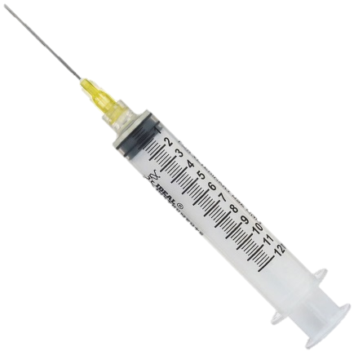
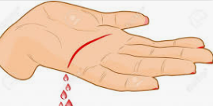
Exposure is…
Skin Puncture:
Needle stick injury or injury from other “sharps”
Contact with blood or spit:
Broken skin (open wound, rash)
Mucus membrane (eyes, nose, mouth)
Bitten resulting in blood
Notes:
Abandoned needles are a problem in all regions of the City. Needles are the leading risk factor for infection from BBPs.
Highest risk exposure is needle stick injuries – i.e. being poked by a discarded syringe.
“Sharps” are any objects that can penetrate the skin (razor, broken glass).
Next highest risk is blood splashing on a recent open cut or wound like a rash (cuts older than three days old = lower risk).
Blood in the eyes, nose or mouth is also a risk.
Contact with spit requires a substantial amount of saliva entering the eyes, mouth or nose.
Bitten by another human requires that blood results from the wound.
If any of the following events occur then you are considered to have been exposed to blood or body fluids and you will need to follow the City’s exposure protocol.
Also, from outside of workplace there is a risk if you engage in sexual contact, illegal drug use, tattoo application, or contact w/blood and bodily fluids.

Slide 8
Exposure is not…
Spread through contact with blood or spit on intact skin
Spread through the air like the flu virus
Notes:
Skin is a very good barrier, but its important to wash thoroughly w/warm, soapy water for 5 mins.
Regular hand washing is 30 seconds
*no soap if you are washing mucous membranes (eyes, nose, mouth).
No risk by sharing lockers or toilet facilities, a swimming pool or by being in care of an individual infected w/BBP.

Slide 9
Infection risk
Exposure to blood known to be infected:
Hepatitis B: 5% to 30%
Hepatitis C: 3% to 10%
HIV: 0.3% - needle exposure
Notes:
All employees should practice Standard Practice to assume all blood/bodily fluids are infectious, whenever they are at risk of BBP exposure.
So imagine that I have an infected needle and I poke you with it. What is the chance you would become infected?
Hepatitis B has a large range because infected people can have active Hep B where they have very high concentrations of virus in their blood, or chronic Hep B which is in remission with low levels of virus in their blood. The numbers of viruses in the blood is a strong predictor of how infectious the blood is.
Hepatitis C has lower rates of infection because it does not replicate quickly for high virus levels in the blood.
HIV virus is very delicate and lasts only for a few seconds to a few minutes outside the body. The risk of infection to HIV by needle stick injury is very small compared to the other viruses.

Slide 10
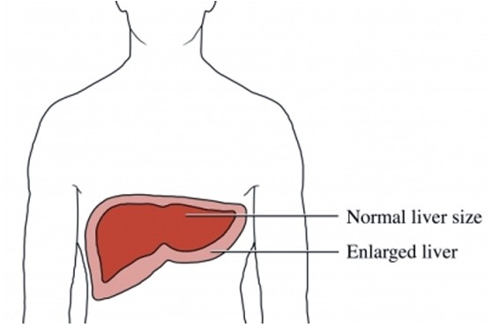
Hepatitis B
Virus may live up to 1 week outside of the body
50% of infected people have no symptoms
5 to 10% of infected people become “chronic carriers”
Symptoms: flu-like, stomach ache, dark urine, jaundice
Immunization Program!
Notes:
Hep B virus causes health problems, ranging from liver swelling, permanent liver damage and scarring to liver cancer.
This Hep B virus is quite tough - the virus can live in a smear of blood on a table for up to about a week.
Within 6 months of being infected, about 90% of adults will clear the virus on their own and develop lifelong protection against it. 10% who are infected are unable to clear the virus and will become chronic carrier (i.e. chronically infected and infectious). Chronic Hep B is treatable, but they will be infectious to others and can develop chronic liver damage. If a person lives with Hep B infection for a number of years then they may develop more serious health complications.
For more information, refer to the Hepatitis B SDS located in Appendix B of the ECP.
There’s no cure, but there’s a vaccine available!!

Slide 11
Hepatitis C
Virus may live several hours to a few days outside of the body
~25% of infected people will clear the virus from the body within 6 months – not immune forever!
80% of infected people have no symptoms
75% of infected people become “chronic carriers”
Symptoms: flu-like, stomach ache, dark urine, jaundice
No vaccine available
Anti-viral treatments have about a 90% cure rate
Notes:
Can cause similar symptoms to Hep B, but more likely to cause chronic hepatitis, liver scarring and cancer.
About 20% of individuals who become infected with HCV will clear the virus from their body within 6 months, though this does not mean they are immune from future infection.
The other ~75% of people will develop chronic hepatitis C infection, during which the virus may cause mild symptoms or no symptoms at all. These people will however carry the virus and remain infectious to others.
There are direct-acting antivirals (DAAs) pills that act on the virus itself to eradicate it from the body. The pills have to be taken for 8 to 24 weeks (~90% cure rate). https://www.liver.ca/patients-caregivers/liver-diseases/hepatitis-c/
If a person lives with HepC for a number of years, then they may develop the following complications: chronic hepatitis, liver cirrhosis, liver cancer.
For more information, refer to the Hepatitis C SDS located in Appendix B of the ECP.
(http://www.catie.ca/en/fact-sheets/epidemiology/epidemiology-hepatitis-c-canada)

Slide 12
HIV
Virus dies within seconds of being outside the body
Attacks the immune system
Progresses into AIDS
No one in North America or Europe has contracted HIV from “abandoned” needles
St. Paul’s Hospital is unlikely to start HIV drugs for a person who is stuck by an “abandoned” needle – very low risk of infection!
Notes:
Human Immunodeficiency Virus
Virus enters body to infect cells that needs to fight against infection…gradually destroys immune system and causes body unable to resist against illnesses & infections.
No cure, but there are drugs to increase longevity.
Can carry HIV for years and not have AIDS, but still be infectious.
Remember, HIV dies within a few seconds to a few minutes of exposure to the outside, so contacting HIV from an abandoned needle unlikely.
For more information, refer to the Human Immunodeficiency Virus SDS located in Appendix B of the ECP.

Slide 13
Risk of working around needles
Picking up needles for disposal
Putting hands where there is not a clear view such as:
Cleaning away debris to access something
Reaching into something to feel for something
Notes:
City workers have been poked by needles from:
Removing leaves from under bushes with their hands, instead of a tool like a rake.
Carrying garbage and having the bag rub against their legs and feeling a needle poke.
Cleaning in areas they cannot see – door jams, etc.
A plumber once reached up into a blocked toilet and got a needle stick injury from a needle that was blocking the toilet.

Slide 14
Risk of blood contact with open wounds
Splashed with blood
Spat on (with blood)
Blood soiled surfaces
Blood soiled materials
Notes:
Contact with blood is usually associated with first aid emergencies.
The more blood someone is exposed to the greater the risk.

Slide 15
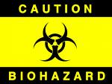
Safe Practices
Use Universal Precautions!
Follow Safe Work Procedures
Never recap needles
Wear PPE
Wash hands
Notes:
Universal Precautions means that you assume all items with blood, bodily fluids, or suspect fluids are CONTAMINATED with blood borne pathogens and treat them as such.
PPE = Personal Protective Equipment
Gloves for picking up needles
Safety eyewear or even a face shied may be required when cleaning a large body fluid spill

Slide 16
Safe Work Procedures
Abandoned Needle Pickup
Cleaning Human Waste
Cleaning Blood and Body Fluids
Disposable Glove Removal
Hand Washing
Cleaning Tools
Notes:
These Safe Work Procedures are found in the ECP, Appendix C. Go though the relevant safe work procedures with your staff.
Ensure participants are familiar with these procedures, and know where to find the procedures on site.
Go over the specific procedures that are applicable to the participants.

Slide 17
Safe Needle Disposal

Slide 18
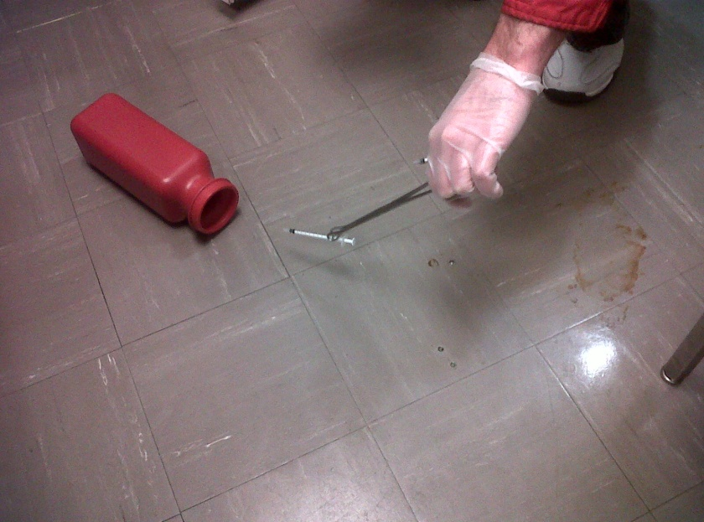
Safe Needle Disposal
Wear gloves
Place open sharps container on the ground beside the needle
Use tongs/pliers to grasp the needle
Place in container with needle down
Close sharps container
Notes:
Refer to the ECP, Appendix C for Abandoned Needle Pickup procedure.
Remember:
Never bring the needle to the container!!
After using the tongs, pliers or paper pickers make sure they are disinfected with a quaternary ammonium cleaner.
Refer to ECP Section 7.3 for information on disinfecting cleaners.

Slide 19
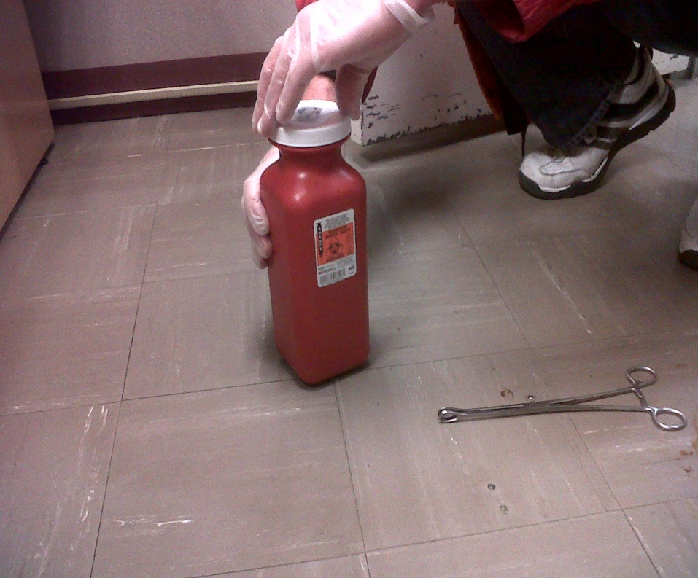
Safe Needle Disposal

Slide 20
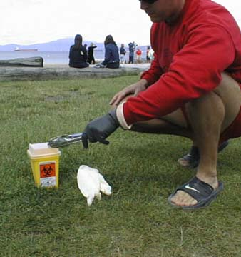
What’s wrong with this picture?

Slide 21
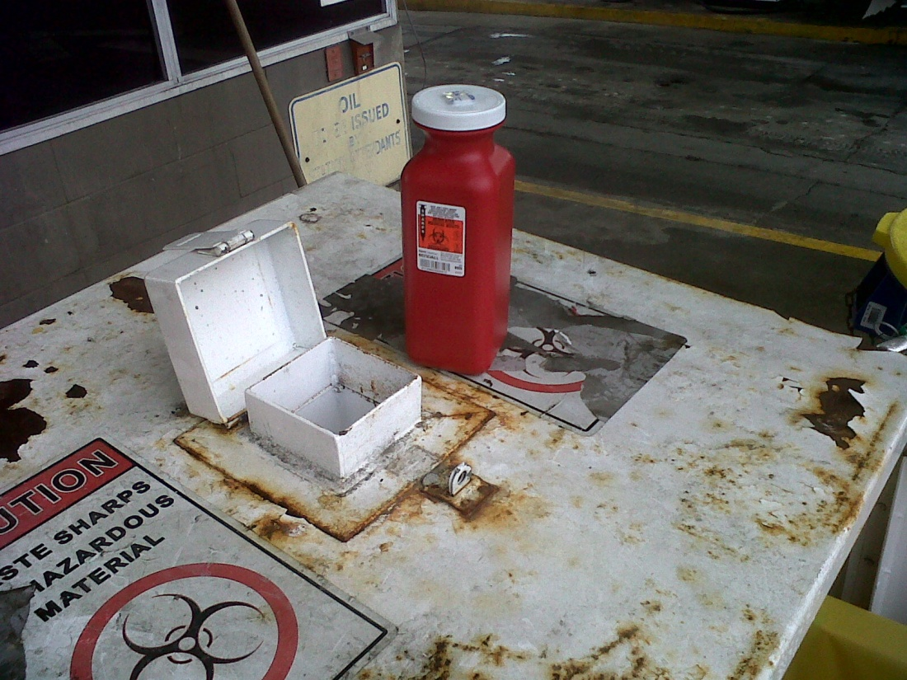
Disposing of full containers
Discard containers when 2/3 full
Needle Disposal Bins located at National Yard, Manitoba Yard or Vancouver South Transfer Station (VSTS)
Non-mobile work groups can contact the Mobile Needle Exchange
Notes:
Provide information on how needle containers are disposed of (and replaced) at the worksite.
Disposal Option:
Full Sharps containers can be disposed of by dropping off at the National Works Yard gas station (700 National Avenue).
For small needle containers (e.g. the red containers) - Drop these into the white biohazard bin at the gas station (lift lid and drop).
For all other sized containers - Ask the gas station attendant to take you to the biohazard cabinet, where you will place the container into the cabinet.

Slide 22
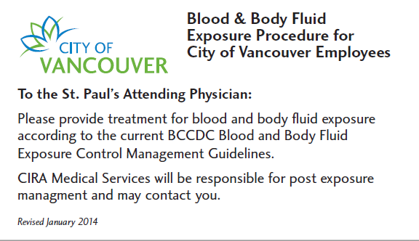
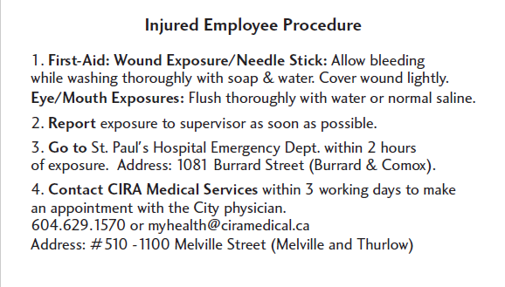
In the event of exposure
Go to First Aid
Report to your supervisor
Go to St. Paul’s Hospital
Contact CIRA Medical Services
Never bring a needle to the hospital with you
EAP is available
Notes:
Provide the Blood and Body Fluid Exposure card to participant(s).
Go through both sides of the card in detail.
Advise participant(s) to keep this card with them at all times while working.
Missing cards will be replaced – just ask.

Slide 23
Summary
Remember
Use Universal Precautions!
Follow Safe Work Procedures!
Get immunized!
Report exposure incidents to your supervisor!

Slide 24
Questions?

