Slide 1
SAFETY ORIENTATION
FOR NEW OR RETURNING WORKERS
Notes:
Provide safety evacuation information, let the participants know where the washrooms are, etc.
Make sure everyone has a copy of the New Worker Orientation Package and a pen.
Introduce yourself, your position, explain how long the orientation is expected to last (approximately one hour for the general orientation)

Slide 2
Welcome to [your organization]
Safety is the priority for everyone working here
To help you start to work safely, we provide three levels of orientation
SITE SPECIFIC
DEPARTMENTAL
GENERAL
Notes:
There are three levels of orientation provided by [your organization]: Each one builds on the one before.
General safety orientation, which we are doing here. This gives you basic information you will need to understand the hazards in every position in our organization.
You will receive a Departmental or Divisional orientation, which will give you information on any additional hazards you may be exposed to within your department, and on specific ways you can lessen those hazards.
Finally, you will receive site- or task-specific orientation and training, for the job you will be doing. In some cases, you may NOT perform work until you have received specific training. Examples of this are Confined Space Entry training, Excavation safety training, or Lockout training, to name just a few. If you will be operating equipment or machinery, your supervisor will need to assess if you are capable of operating that equipment or machinery safely, before you will be allowed to do so.

Slide 3
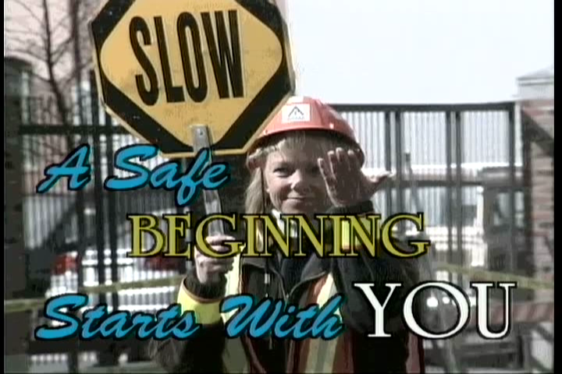
Video
Notes:
We want you to be able to do your job safely, and to be able to return home at the end of the day without suffering a work-related injury or illness.
There are hazards in every job, no matter what that job is.
If you know what the hazards are, you can take steps to eliminate them, or to at least lessen the level of risk. If you eliminate or lessen the hazards, you will be able to do your job safely.
We’re going to show a short video created by the BC Municipal Safety Association entitled “A Safe Beginning Starts with You”.
The video gives general safety hazards found in any municipality, regardless of which department you work in.
We will review some of the topics covered in more detail.
(play 17 minute video)

Slide 4
OH&S Program Components
(list the components here if different)
Organizational Commitment
Programs and Procedures
Hazard Identification and Risk Assessments
Training, Education and
Certification
Notes:
[your organization] Has a formal Occupational Health and Safety Program.
(the eight elements in the Local Government Safety Management System are listed in the next two slides. If your safety program has different elements, you will need to change these slides and script)
First, Organizational Commitment. Everyone in our organization, from the Mayor and Council through all levels, are committed to providing a safe and healthy workplace, and providing the resources to make that possible.
We have programs and procedures in place to help workers do their jobs safely.
All work within [your organization] has been assessed for hazards, and risk assessments have been completed to ensure those hazards have been lessened or eliminated.
Workers require training, education, and in some cases, certification to do their jobs safely. Sometimes you need to have certification before you can work here, and in many cases you require training and education before you can perform some of the work you will be assigned. Records are kept of all training and education.

Slide 5
OH&S Program Components (continued)
Inspections
Incident Investigations
Program Administration
Joint Health and Safety Committee
Notes:
We perform regular scheduled inspections of all premises. Supervisors and workers are also required to perform inspections of their workplaces, equipment and machinery. We have a preventative maintenance program for our mobile equipment.
If a worker is injured and requires medical attention, or if there has been a near miss incident – that is, something that could have resulted in an injury or damage to equipment but by some fluke didn’t – we will conduct incident investigations. The investigation team is made up of the worker, the workers supervisor, and a member of the Occupational Health and Safety Committee. [or indicate who does investigations in your organization]
We keep records and statistics of everything pertaining to our Health and Safety Program. This documentation is reviewed regularly to help improve our Program.
Finally, we have a Joint Health and Safety Committee. This committee’s purpose is to oversee the Safety Program, and to make recommendations to improve worker safety. (insert information on how often they meet, where to find the list of names, etc)

Slide 6
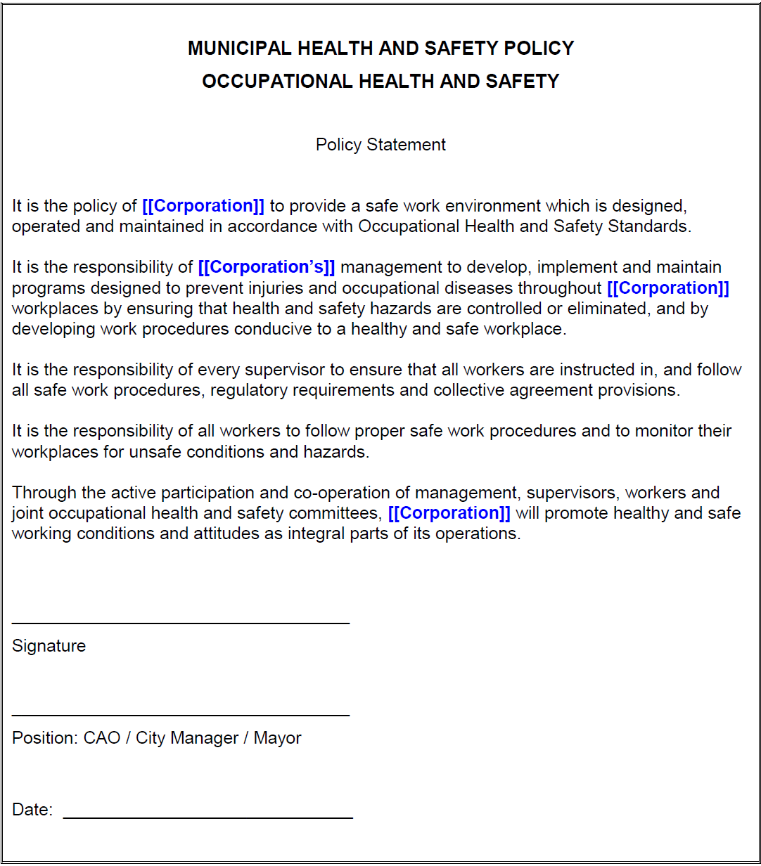
SAFETY
POLICY
(insert your safety policy here)
Notes:
Part of the organizational commitment section of our program is contained in our Safety Policy. The policy outlines the responsibilities of the organization, managers, supervisors, workers and contractors.
[Review your organization’s safety policy here. If you don’t have one…..you need to create one, in communication with all levels of the organization.
For help with this component, see the BCMSA website:
www.bcmsa.ca Resources > Supplemental Safety Programs
The OH&S Program Shell contains information on creating a safety policy]

Slide 7
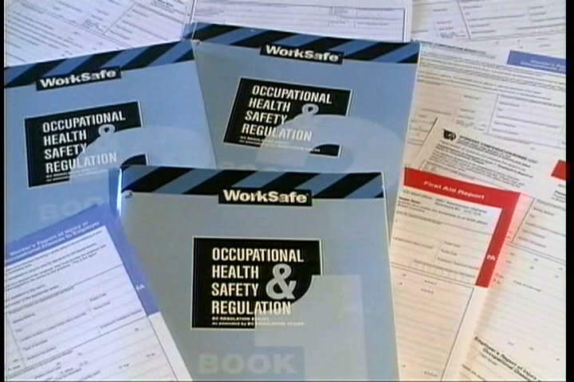
Responsibilities
The Organization
Managers
Supervisors
Workers
Notes:
[your organization] is responsible for providing resources to ensure a safe workplace.
Managers and Supervisors are responsible for:
Ensuring the health and safety of all workers under their direct supervision;
being knowledgeable about WorkSafeBC Regulations and the Workers Compensation Act applicable to the work they supervise
Ensuring that workers under their direct supervision are made aware of all known or reasonably foreseeable health or safety hazards in the area where they work
Conducing and documenting safety orientations for new or young workers
Workers are responsible for:
Participating in the Safety Orientation process and any applicable safety training;
Following any safe work procedures established for their positions, including proper use of personal protective equipment;
Notifying their supervisor of any incident or hazard

Slide 8
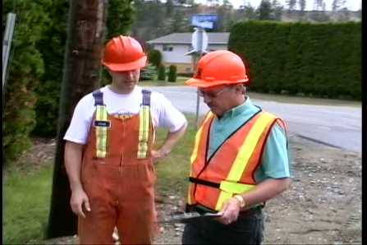
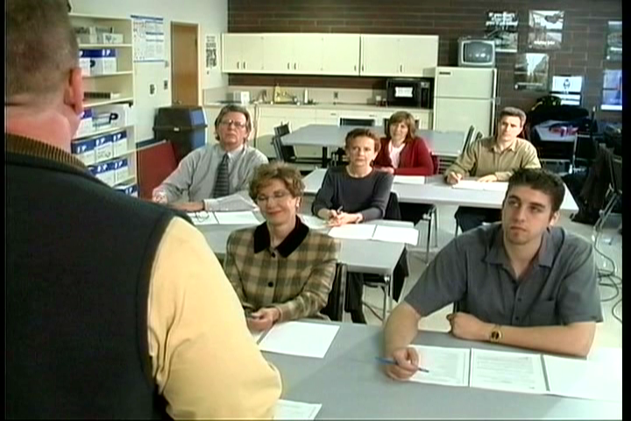
Every employee has a right to:
KNOW THE HAZARDS
PARTICIPATE IN SAFETY ACTIVITIES
REFUSE UNSAFE WORK
Notes:
The Workers Compensation Act outlines three basic worker rights:
(click)
All employees have a right to know what hazards are present on the job, and how these hazards can affect them
(click)
All workers have the right to participate in health and safety activities in the workplace. This may include becoming a safety representative or a member of the joint health and safety committee.
A worker also participates in health and safety activities in the workplace by correcting hazards, or reporting hazards to their supervisor if they are unable to correct them themselves. And… (click)
Under the Workers Compensation Act, workers have the right to refuse work where they have reasonable cause to believe that to do so would create an undue hazard to the health or safety of any person.

Slide 9
Right to Refuse
If they have reasonable cause to believe that to do so would create an undue hazard to the health or safety of any person
Notes:
Let’s talk a bit more about the right to refuse unsafe work.
What this means is that if you are asked to do something that you feel is unsafe for you or for another person, you have the right – and the obligation – to say you feel it is unsafe. You have the right to refuse to do that work until you are satisfied that it is safe.
Talk to your supervisor. He or she must listen to your concerns, and investigate them. If the situation is unsafe, the supervisor must remedy it immediately. It may also be possible that the work is safe, but you haven’t been made aware of the safety precautions being taken.
If, after talking to your supervisor and any action has been taken, if you still feel it is unsafe to do the work, a joint health and safety committee will participate in an investigation into the matter.
If you, the supervisor and the safety committee member are not able to resolve the situation, WorkSafeBC is contacted to assist.
No worker can be disciplined for refusing to work if they have reasonable cause to believe that to do so would create an undue hazard for them or anyone else.

Slide 10
Know the Hazards
Working Alone or in Isolation
Workplace Violence
Biohazards/Hep A and B Vaccination
WHMIS
Hearing Conservation
RSI’s and MSI’s
(add additional known/foreseeable hazards)
Notes:
The Safe Beginnings video covered a lot of general safety concerns, including most of these listed here. Now we’ll get into them a little further.

Slide 11
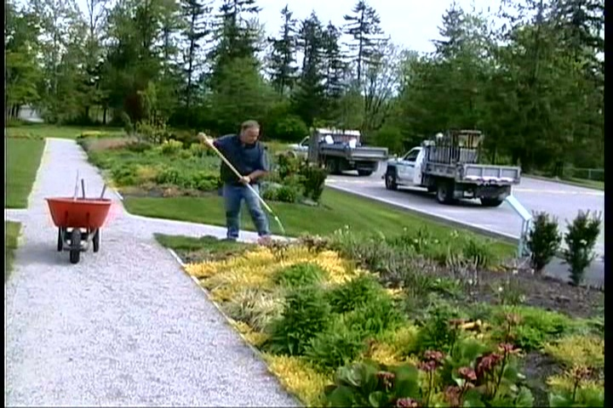
Working Alone or in Isolation
Check in/out at beginning or end
Periodic check-in’s throughout day
Notes:
If you are assigned to work alone or in isolation, you will receive instruction in the check-in procedure.
The process could be as simple as making sure you check in with your supervisor at the beginning and end of your shift. This would apply if the work you are doing would not place you at a higher level of risk than anyone else.
If your work could place you in danger (for instance, by-law officers, inspection personnel, public works staff), you will be required to call in on a regular basis. Your direct supervisor will give you complete information on the check-in procedure.

Slide 12
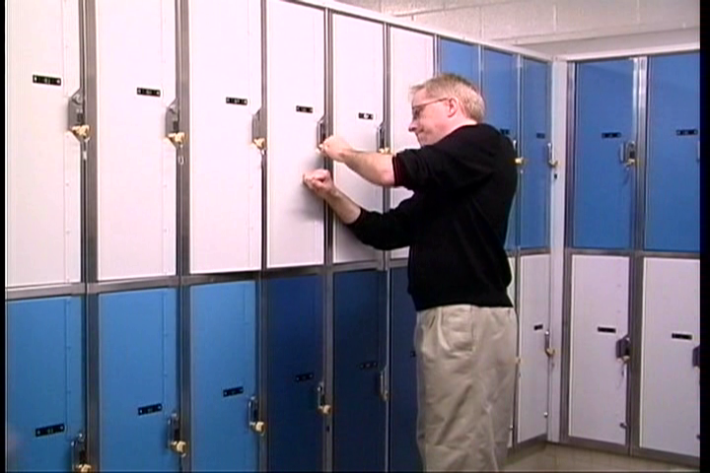
Violence in the Workplace
Non-worker to worker
A potential hazard for all staff
Notes:
The video showed a member of the public slamming the locker in a recreation facility. It’s a sad fact that just because we work for the public, we sometimes become targets of physical or verbal abuse. There have been many instances of violence in municipal workplaces. You are not expected nor encouraged to get into a confrontation. You will receive further training in prevention of workplace violence. Before then, if you expect a situation to have the potential for violence, remove yourself from that situation. If you can talk to the person in a calm manner and defuse the situation, you should do so. Always report the situation to your supervisor. More information soon on the reporting process.
[give information on your Prevention of Workplace Violence program]

Slide 13

Biohazard Control program
UNIVERSAL PRECAUTIONS
VACCINATION PROGRAM
Notes:
We have a Biohazard Control Program.
Biohazards are present in many workplaces. We follow a protocol known as Universal Precautions. If you are exposed to blood or body fluids, you always treat it as if it is infectious.
[if true – let workers know of locations of hand disinfectant stations] Good personal hygiene is an effective prevention against biohazards. Clean, intact skin is an effective barrier. Wash your hands regularly and well, with soap and water.
We have a vaccination program for any workers who may be exposed to Hepatitis A or Hepatitis B. These are diseases that can cause serious liver disease and even death. If you could have a potential exposure to either of these from the work you do, your supervisor will offer you an opportunity for the vaccine.

Slide 14
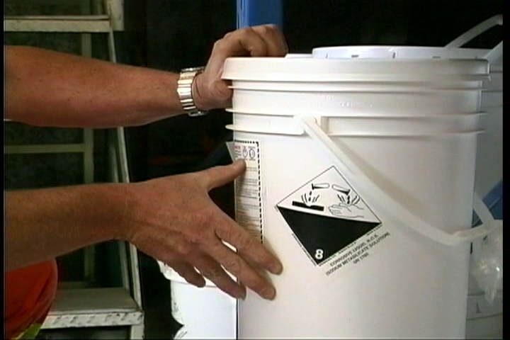
Workplace Hazardous Materials Information System
(WHMIS)
Workers have a right to know the hazards of the products they work with
Three components:
  Classification
  Labeling
  Material Safety
  Data Sheets
Notes:
All workers have a right to know the hazards of the products they will be working with. If you are required to work with hazardous products, your supervisor will ensure you have WHMIS training in how to use and store that product safely. Here is a brief introduction into WHMIS.
There are three components to the WHMIS program:
Classification of the product – that is, determining if the product is hazardous, and what classification it falls into. Suppliers are required to provide this information.
Labeling – when we receive a product in the workplace, it has a WHMIS label on it from the supplier. The label includes product information, classification, safe handling instructions, personal protective equipment required, and a reference to the Material Safety Data Sheet. If some of the product has been transferred to a workplace container, it will have a workplace label on it, which has the product identifier, safe handling information and reference to the third component….
The Material Safety Data Sheet. We have one for every controlled product in the workplace. You must be told where these are located and must review it before using the product. MSDSs can be no more than three years old. Material Safety Data sheets have information on how to use the product safely, how to store it, and what first aid procedures to follow should a worker be exposed to the product unsafely.
If we don’t have a current MSDS for the product, or if proper labels are not on the containers, DO NOT use the product, and point out the missing information to your supervisor.

Slide 15
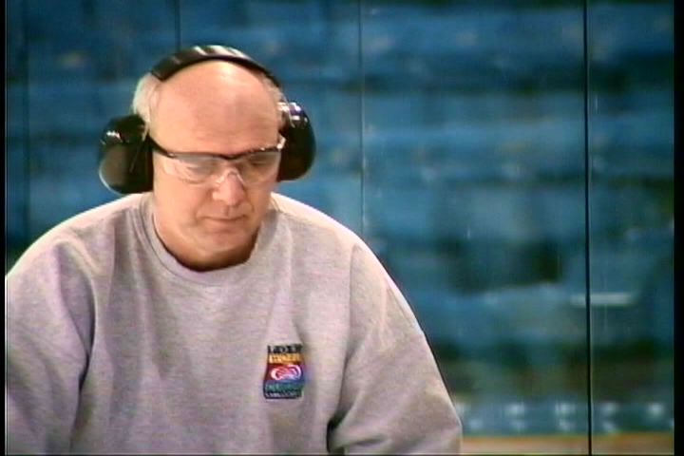
Hearing Conservation Program
Annual hearing tests for workers exposed to loud noise
Hearing protection provided by employer
Notes:
We have a hearing conservation program.
If you are exposed to loud noise in your workplace, you will be given an annual hearing test to track your hearing ability and identify if your hearing protection is providing sufficient protection.
We have a variety of hearing protection available for your use. Your supervisor will discuss this further.

Slide 16
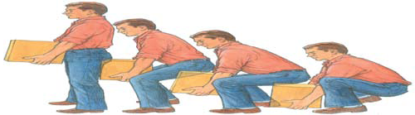
RSI’s and MSI’s
Repetitive Strain Injuries
  Risk lessened by workstation set-up and varying the work
Musculoskeletal Injuries
Manual Material Handling
Safe lifting procedures
Notes:
The number one physical injury in municipalities is strains and sprains. Any worker, regardless of work location, could be exposed to injury, through repetitive work such as keyboarding, or through manual material handling
If you work at a computer workstation, it is important that it be set up properly for you. [direct the person to the workstation design hand-out]. As equally important in reducing the danger of an RSI, is for you to vary the work you do regularly. If you are doing a lot of keyboarding, take regular stretch breaks, and vary the work you do – get up to do photocopying for instance – rather than keying continuously.
If you are involved in manual material handling, you need to know that back injuries are common in municipal workplaces. Proper lifting procedures, as well as using lifting aids or asking for assistance from a fellow worker, will help reduce the risk of back injury. The WorkSafeBC Publication “Back Talk” is a good resource and is included in your orientation package.

Slide 17
General Safety Rules
(add any organizational general safety rules)
Housekeeping
No horseplay
Fellow worker concept
Use of appropriate personal protective equipment
Notes:
There are a few general rules we’ll discuss here.
[add any other organizational safety rules here]
Good housekeeping is essential. Keep your work area clear of clutter to prevent tripping or slipping hazards. Make sure items are not stacked too high above you which could topple down onto you. If you are responsible for a vehicle or other equipment, keep it clean as well, inside and out.
Horseplay is not permitted. There have been many, many instances where workers were just “fooling around”, that resulted in serious injury or even death. The workplace is no place for horseplay.
The fellow worker concept is simple – everyone should look out for not only themselves, but for their fellow worker. This means that if you see a hazard, take care of it – or let someone know about it – so you or another worker isn’t injured. If you see someone doing something that is unsafe, talk to them about it, or notify someone who can make sure they are trained in how to do that work safely.
You are responsible for wearing appropriate personal protective equipment. Your supervisor will let you know that that is, and how to use it properly.

Slide 18
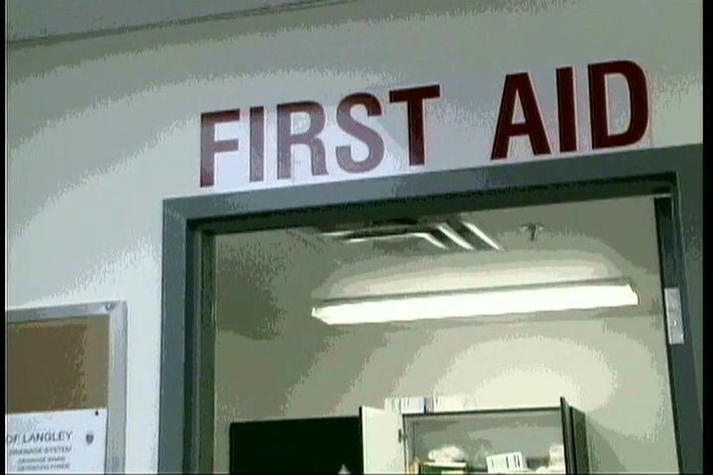
In case of injury or incident…
Report all incidents to your Supervisor
  Including near-miss incidents and hazards
(information on how to report)
(information on where to find forms)
(information on how
to contact first aid)
Notes:
It is required and important that you report all incidents that resulted in either injury, or could have resulted in injury, to your supervisor. You also need to report any incident that resulted in damage to equipment, machinery, or structures. There are several reasons a report is necessary:
First, if you are injured, we need to notify WorkSafeBC. The information you give us is required in order to complete that report and prevent a delay in your claim with WorkSafeBC.
Secondly, we will investigate the incident, in order to make recommendations to prevent it from happening again, preventing another injury to you or a fellow worker.
Finally, it is a requirement of this organization, as well as WorkSafeBC, that these incidents are reported and investigated.
[provide information on the reporting process, where to find the forms, and how to contact first aid in the event of an injury]

Slide 19
If you are injured….
(insert information about your Stay at Work/Return to Work program here)

Slide 20
Any questions?
Notes:
Any questions?
There is a short quiz for you to do, to ensure you understand the information presented in this general safety orientation. We will review all the answers after you’ve had a chance to take the quiz.
(hand out the quiz. Give them as long as they need to complete it. Collect the finished exams then go through the answers on the following slides)

Slide 21

Quiz
Notes:
Show this slide while they’re taking the quiz

Slide 22
1. Who do you talk to about any safety concerns?
Supervisor
Safety Coordinator
Occupational Safety Committee
All of the above
Notes:
Okay, now we’ll go through the questions in the quiz to be sure you understood what was presented.
Who do you talk to about any safety concerns?
The answer is D, but you should always start with your Supervisor. He or she is in the best position to answer your question and address any safety hazards you notice. Of course, you can also talk to the safety coordinator or to any member of the OH&S Committee.

Slide 23
2. Employees are responsible to know, understand and follow all applicable WorkSafeBC policies and procedures
True
Or
False
Notes:
This is one of the fundamental worker responsibilities. To know, understand and follow all safety rules and regulations.

Slide 24
3. Workers have a right to know, a right to participate, and a right to_________.
a paycheque
time off
refuse
Notes:
Workers have a right to refuse work if they have reasonable cause to believe that to do so would create an undue hazard to the health or safety of any person.

Slide 25
4. Employees are responsible for ensuring personal protective equipment is properly worn, maintained and stored.
True
Or
False
Notes:
True. It is your responsibility to properly wear, maintain and store your PPE correctly. This means that if you are required to wear PPE for your job, you wear it; you don’t turn your hard hat backwards because it looks better that way; and you are responsible for keeping it in a clean, usable condition and stored properly.

Slide 26
5. Before working with hazardous materials you must have WHMIS training
True
Or
False
Notes:
True. I will give you a brief introduction to WHMIS in a few moments, and you are required to have more in-depth training before working with any hazardous materials.

Slide 27
6. If you work alone or in isolation you will need to have a pre-assigned check-in procedure in place
True
Or
False
Notes:
Also true. We have a person-check system in place in [your organization]. I will give you further information on this in a bit.

Slide 28
7. Injuries must be reported to your supervisor when you get around to it
True
Or
False
Notes:
Absolutely….false.
Injuries must be reported to the supervisor immediately. If you are injured and need to see a doctor, we need that information in order to report the injury to WorkSafeBC and prevent a delay in your claim. And equally as important, we need to determine why the incident happened so we can make recommendations and changes so no one else is injured.

Slide 29
8. If exposed to violence in the workplace, workers are expected to get into a physical confrontation
True
Or
False
Notes:
Again, false. If you are subjected to violence in the workplace, we do not expect you to have to physically defend yourself. You should defuse the situation verbally if you can, or if you can’t, get away from the situation.

Slide 30
9. What type of hazard(s) can office environments contain?
Cluttered areas
Open file drawers
Violence in the workplace
All of the above
Notes:
D. All of the above. There are other potential hazards in your workplace as well, which we’ll discuss shortly.

Slide 31
10. Proper ergonomics can prevent repetitive strain injuries for office workers
True
Or
False
Notes:
This is true. Ergonomics is the process of designing and modifying your work, or your workstation, to fit you.

Slide 32
11. Back injuries are the least common injury in the workplace
True
Or
False
Notes:
False! Back injuries are the MOST common injury in the workplace, usually caused by improper lifting procedures.

Slide 33
12. If an object is too heavy for you to lift you should…
Ask a co-worker for help
Use mechanical means to lift the object
Don’t lift
Any of the above
Notes:
D. All of the above. Do NOT place yourself at risk, never be afraid to ask for help from a fellow worker, or to look for a mechanical means to do the task. If neither of these are available, don’t do the lift and risk injury!

Slide 34
13. You should never try to repair any tool or equipment that is unfamiliar to you
True
Or
False
Notes:
Of course, this is true. Only qualified people may perform repairs on tools or equipment, and if you aren’t familiar with the object, you’re not qualified!

Slide 35
14. You are required to be trained before using tools or equipment
True
Or
False
Notes:
True.

Slide 36
15. Vaccine is provided for workers who could have work exposure to Hepatitis A or B
True
Or
False
Notes:
True. If a worker could be exposed to Hep A or Hep B virus in their work, vaccine is provided free of charge. [identify which workers….usually Aquatic staff, first aid attendants, fire department personnel or workers exposed to sewage]

Slide 37
16. You are required to be trained before entering confined spaces
True
Or
False
Notes:
Confined Spaces, such as manholes, are very dangerous for many reasons. Workers must receive specific Confined Space Entry training prior to working in a confined space.

Slide 38
17. You are required to be trained in fall protection if you work above 10 feet
True
Or
False
Notes:
If you are required to work more than 10’ above ground, or where a fall of less than 10’ could result in serious injury – such as working above rebar for instance – you must be trained in fall protection procedures.

Slide 39
18. You must not do traffic control unless you have been trained or certified
True
Or
False
Notes:
True
Working in traffic is very dangerous. There are specific traffic control rules and regulations that need to be followed. You will need to have specialized training in Work Zone Set Up, or certification in Traffic Control procedures.
[if your organization doesn’t train your own traffic control persons, note that here – that you hire contracted traffic control, but workers are required to have training in how to effectively set up a work zone)

Slide 40
19. Before locking out any machinery or equipment you are required to be trained in lockout procedures
True
Or
False
Notes:
True. Workers must be trained in lockout procedures.
Lockout is the process of applying a physical barrier – such as a lock to a control panel – to prevent equipment from being started up and inadvertently injuring a worker. There are several lockout situations in [your organization].

Slide 41
20. Before working in excavations you are required to be trained in excavation and shoring procedures
True
Or
False
Notes:
True
Any excavation 4’ or deeper must have shoring installed, or must be effectively benched or sloped, to prevent the sides of the trench from collapsing and engulfing the worker. Any worker entering an excavation must receive training.

Slide 42
Summary
There are hazards in every job
If you know the hazards you can take steps to eliminate or lessen them
If you eliminate or lessen hazards you improve your safety

Slide 43
Questions?

Slide 44
Next….
Tour of your work area
Introduction to fellow workers
More specific safety orientation
  Including Emergency procedures
Notes:
We’re just about finished.
Next, you will go on a tour of your work area,
Receive an introduction to your fellow workers, and
Receive a more specific, hands-on orientation and training, into the work you will be doing.
You will also receive instruction in emergency evacuation procedures, and where to marshal in case an evacuation is necessary

Slide 45
Finally….
Welcome to [your organization]
Always ask questions if you are unsure!
If you have any questions, contact
(name and number)
Notes:
Again,
Welcome to [your organization]
You are encouraged to always ask questions at any time.
[add contact information]

Slide 46

One last time…..
Any questions?

